Slide 1
30°

Slide 2
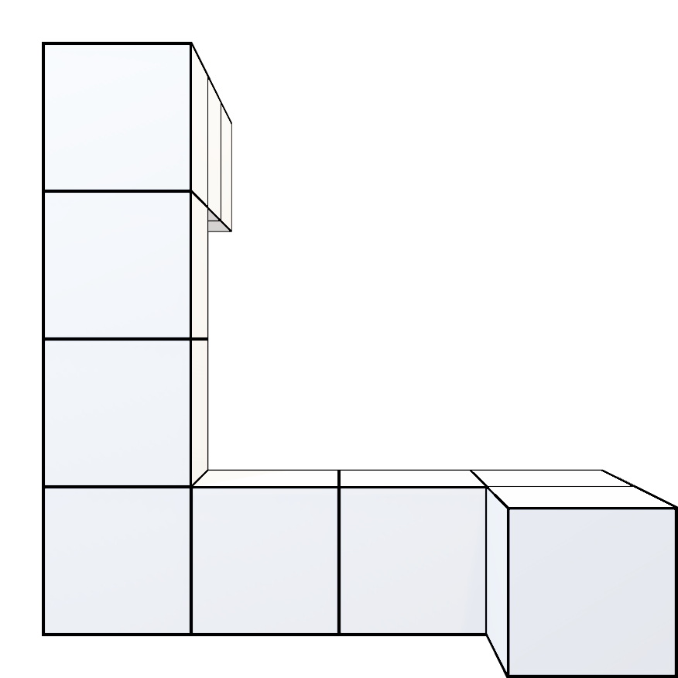
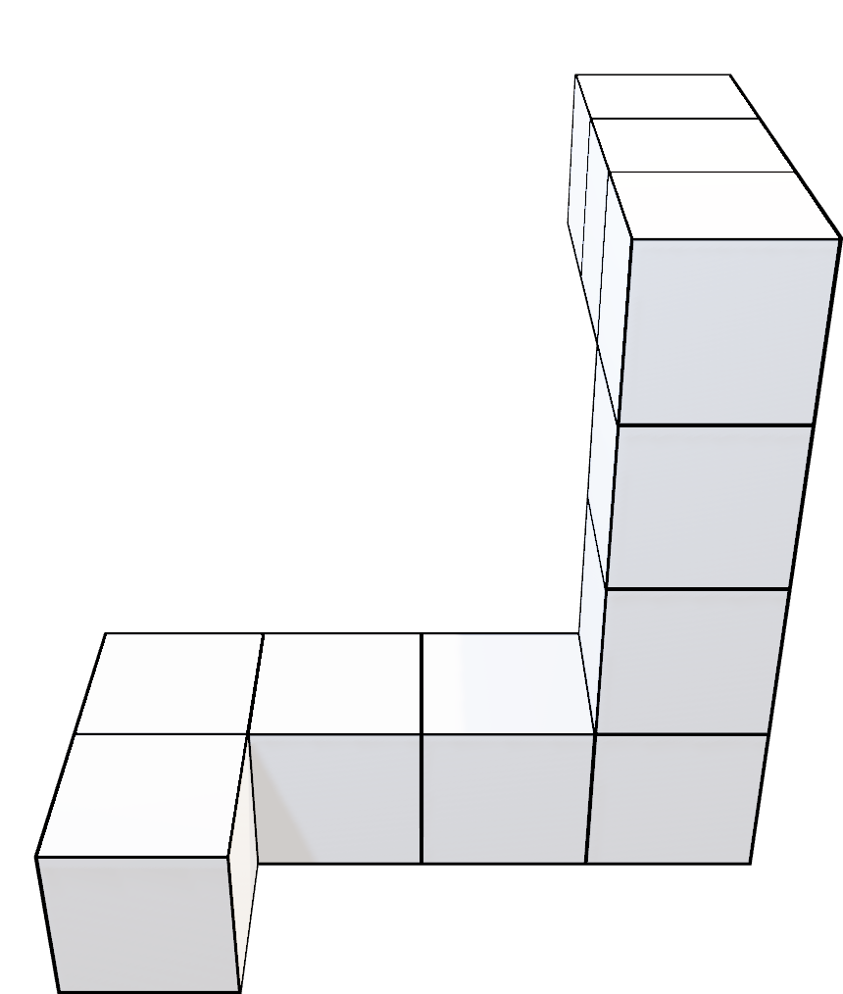
1-1
1-2

Slide 3
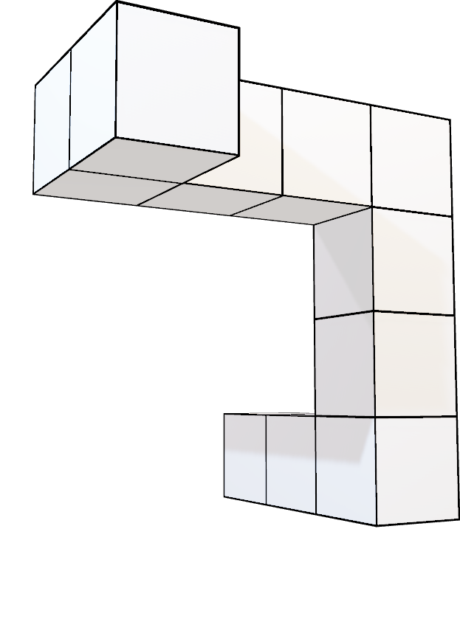
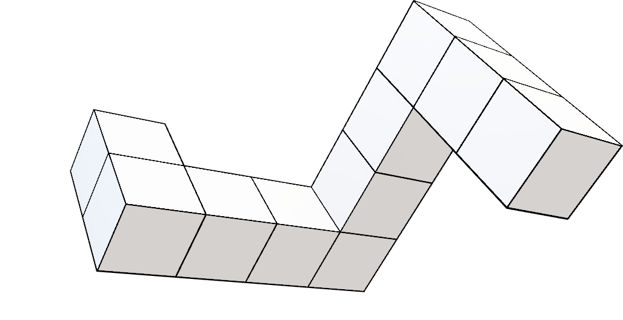
1-1
1-1

Slide 4
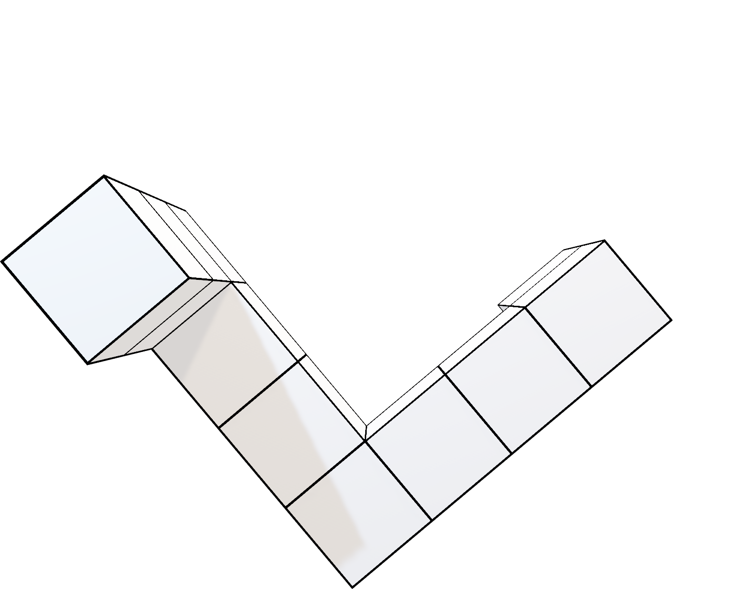
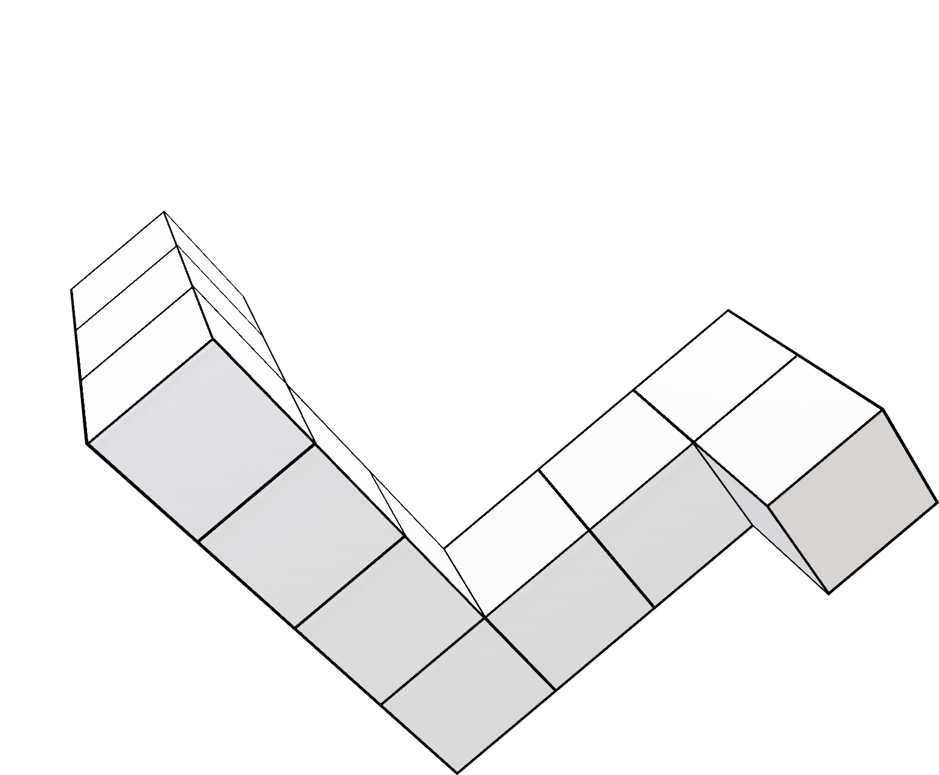
2-1
2-2

Slide 5
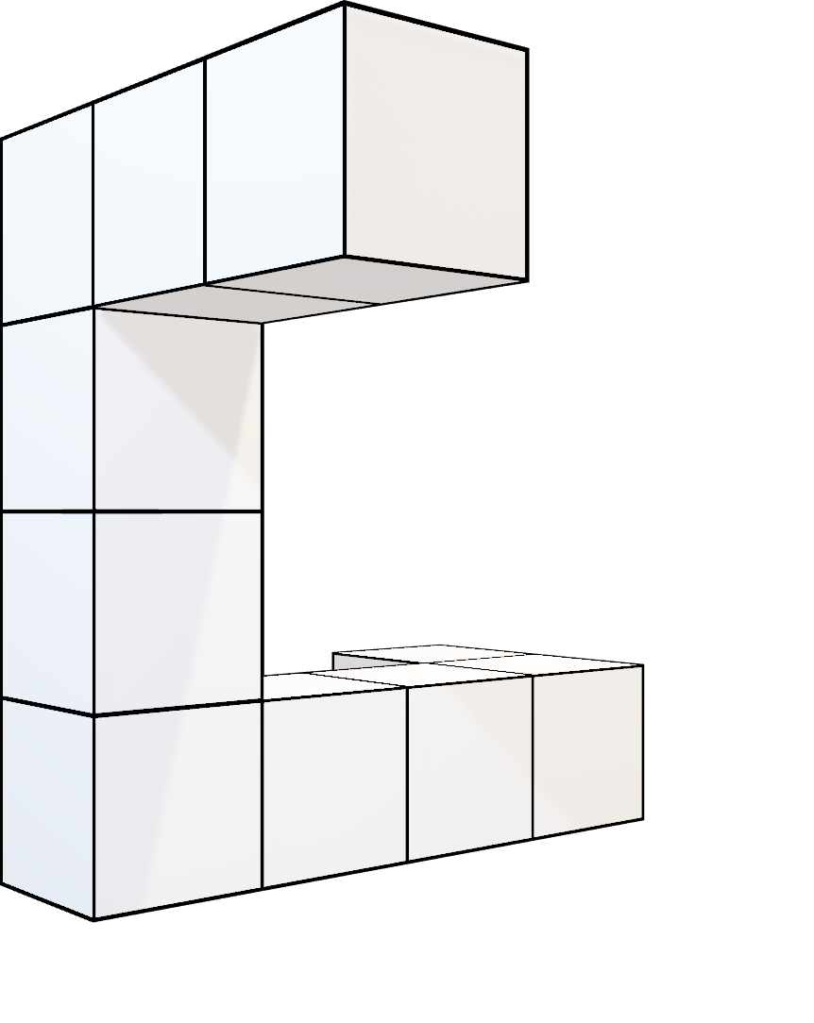
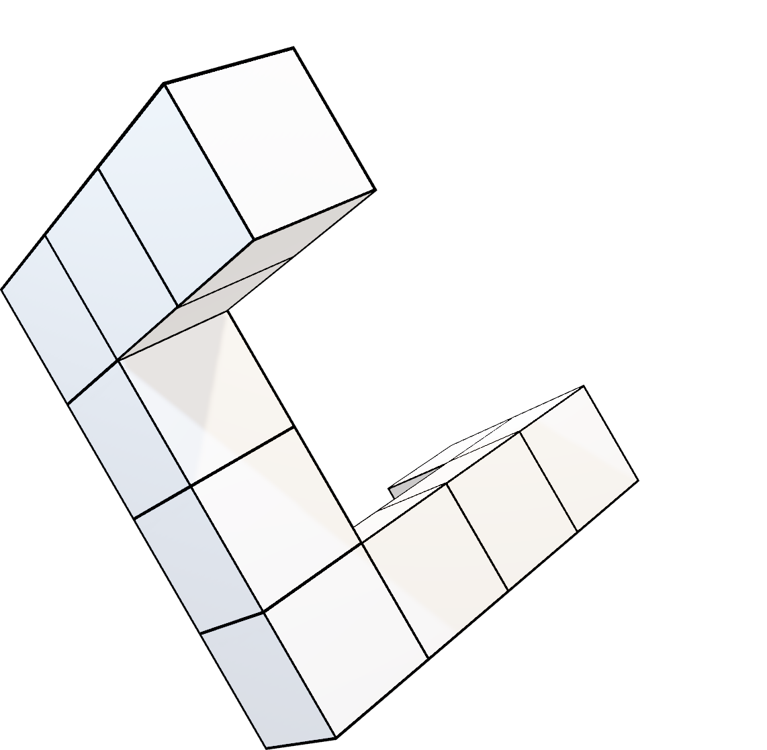
2-1
2-1

Slide 6
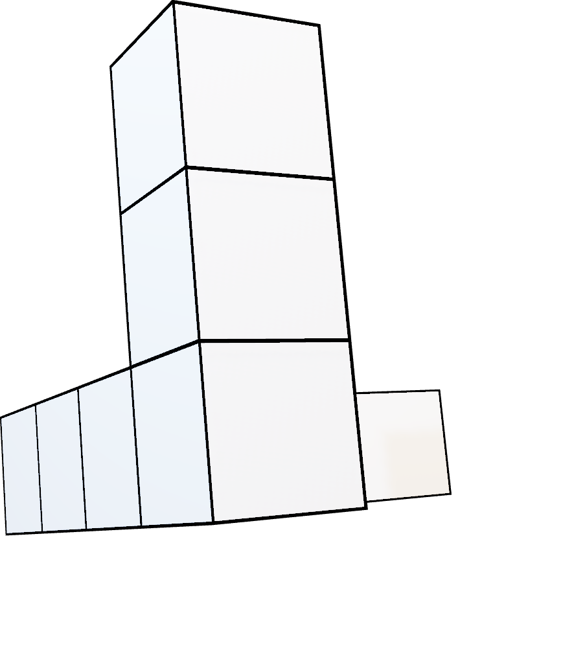
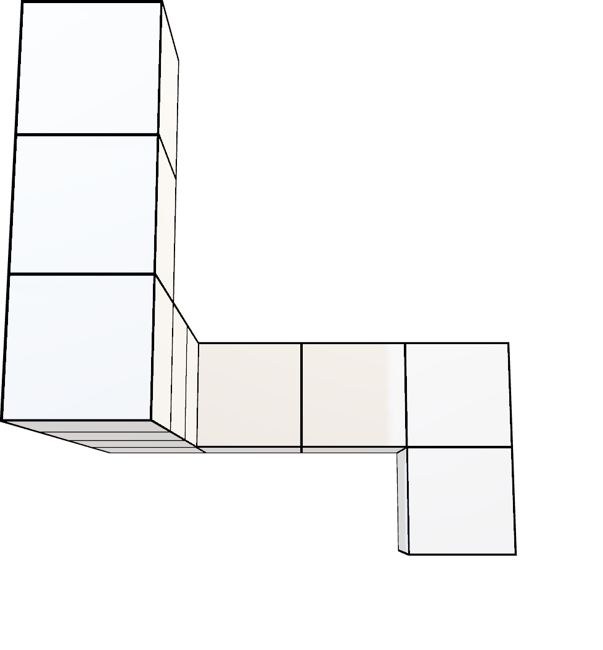
3-1
3-2

Slide 7
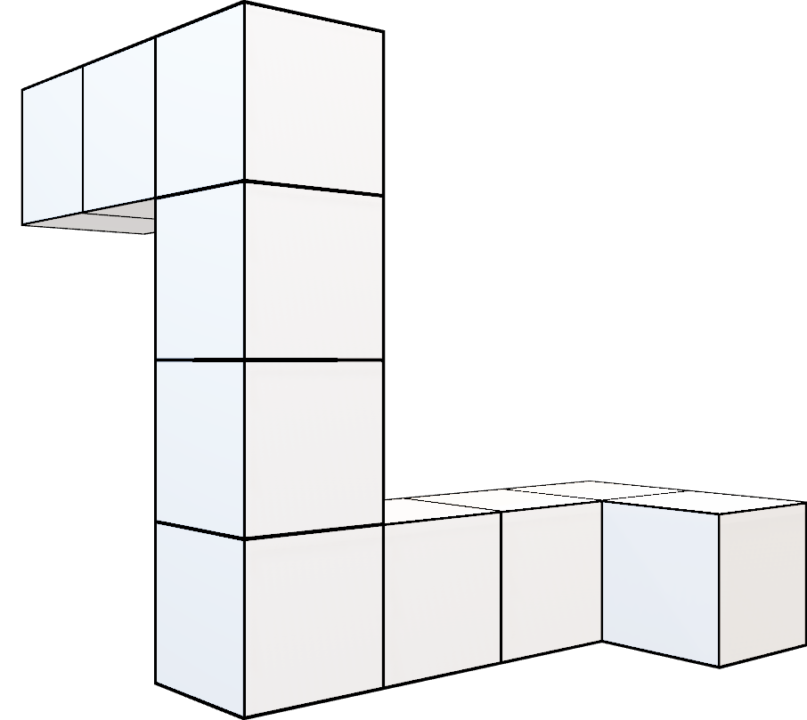
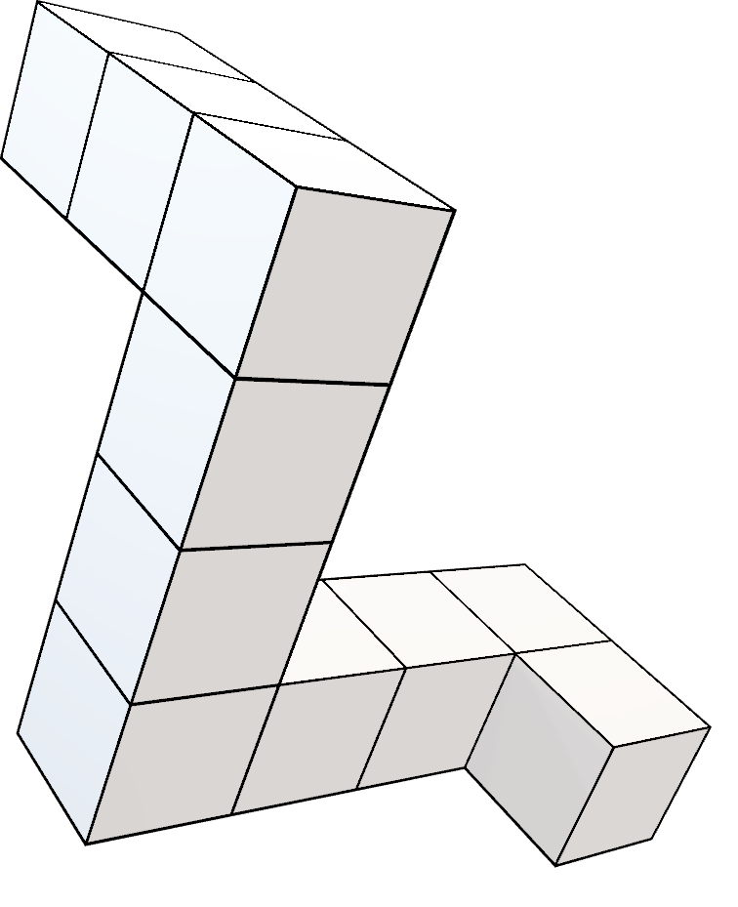
3-1
3-1

Slide 8
60°

Slide 9
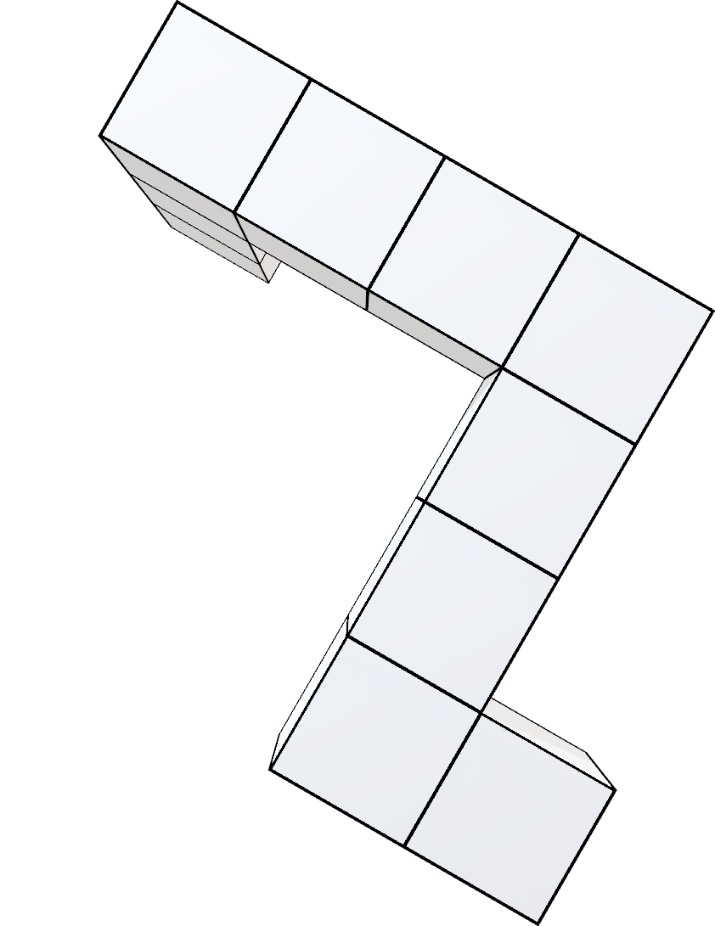
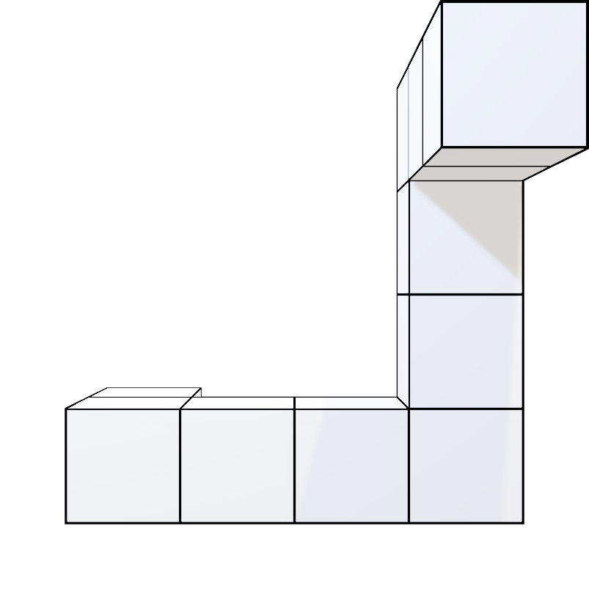
3-1
3-3

Slide 10
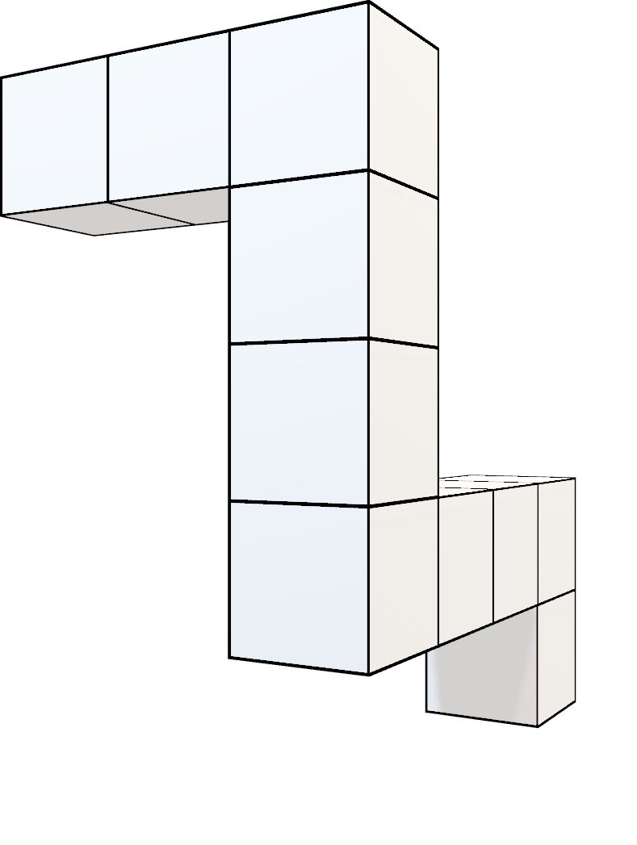
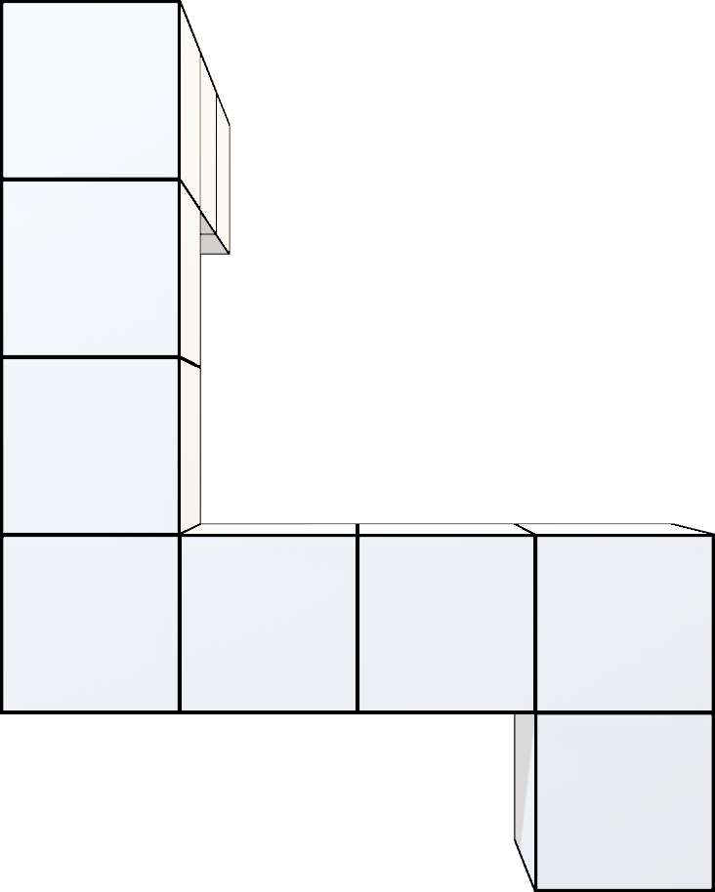
3-2
3-2

Slide 11
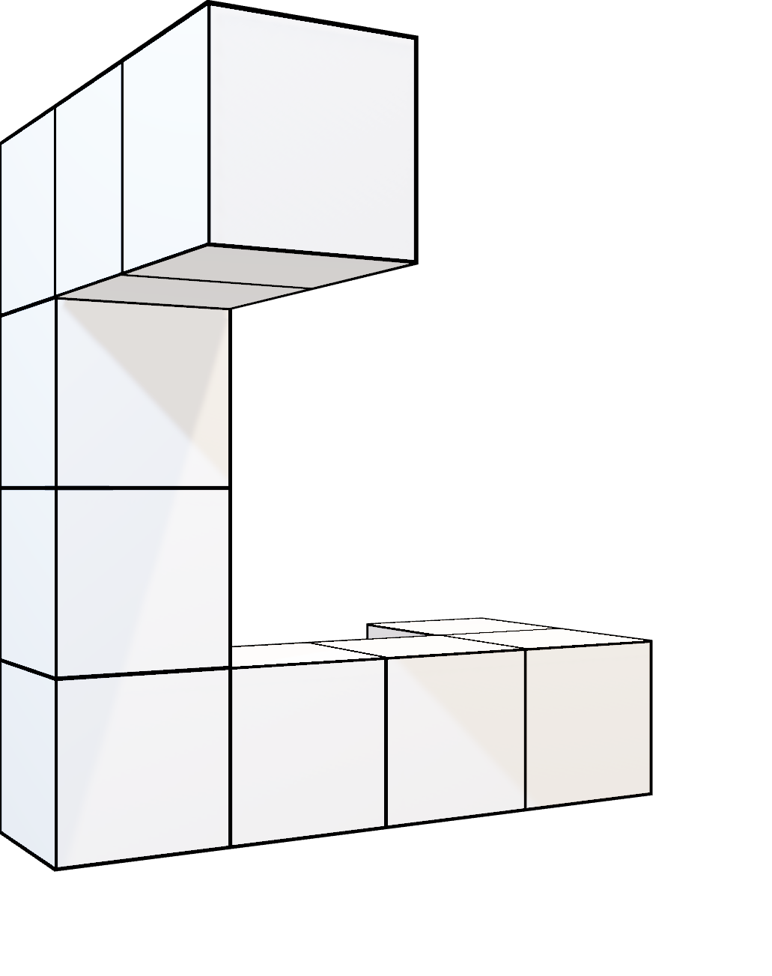
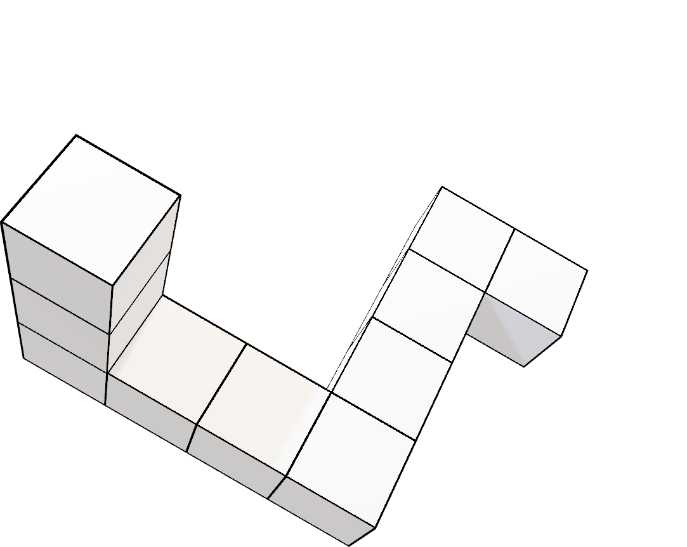
4-1
4-2

Slide 12
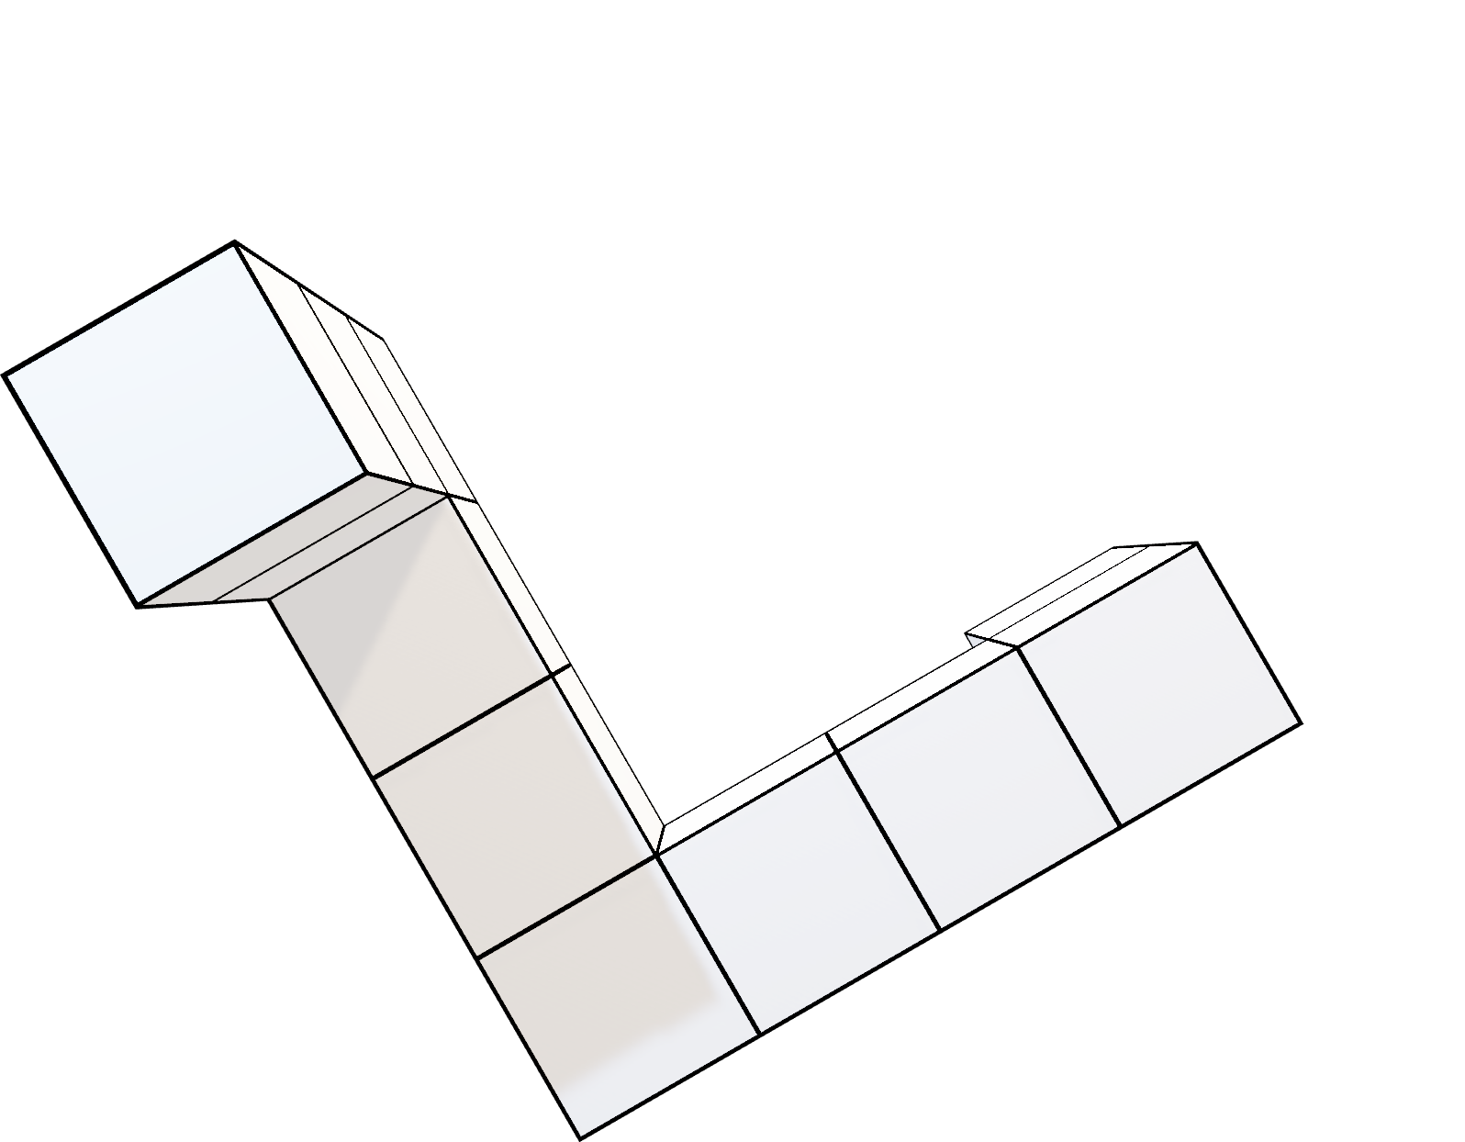
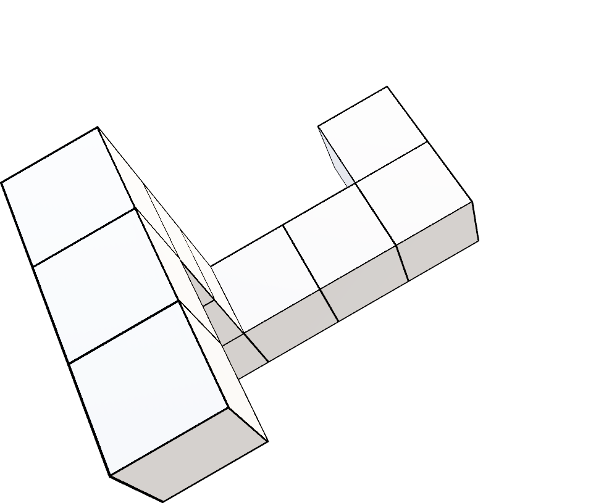
4-1
4-1

Slide 13
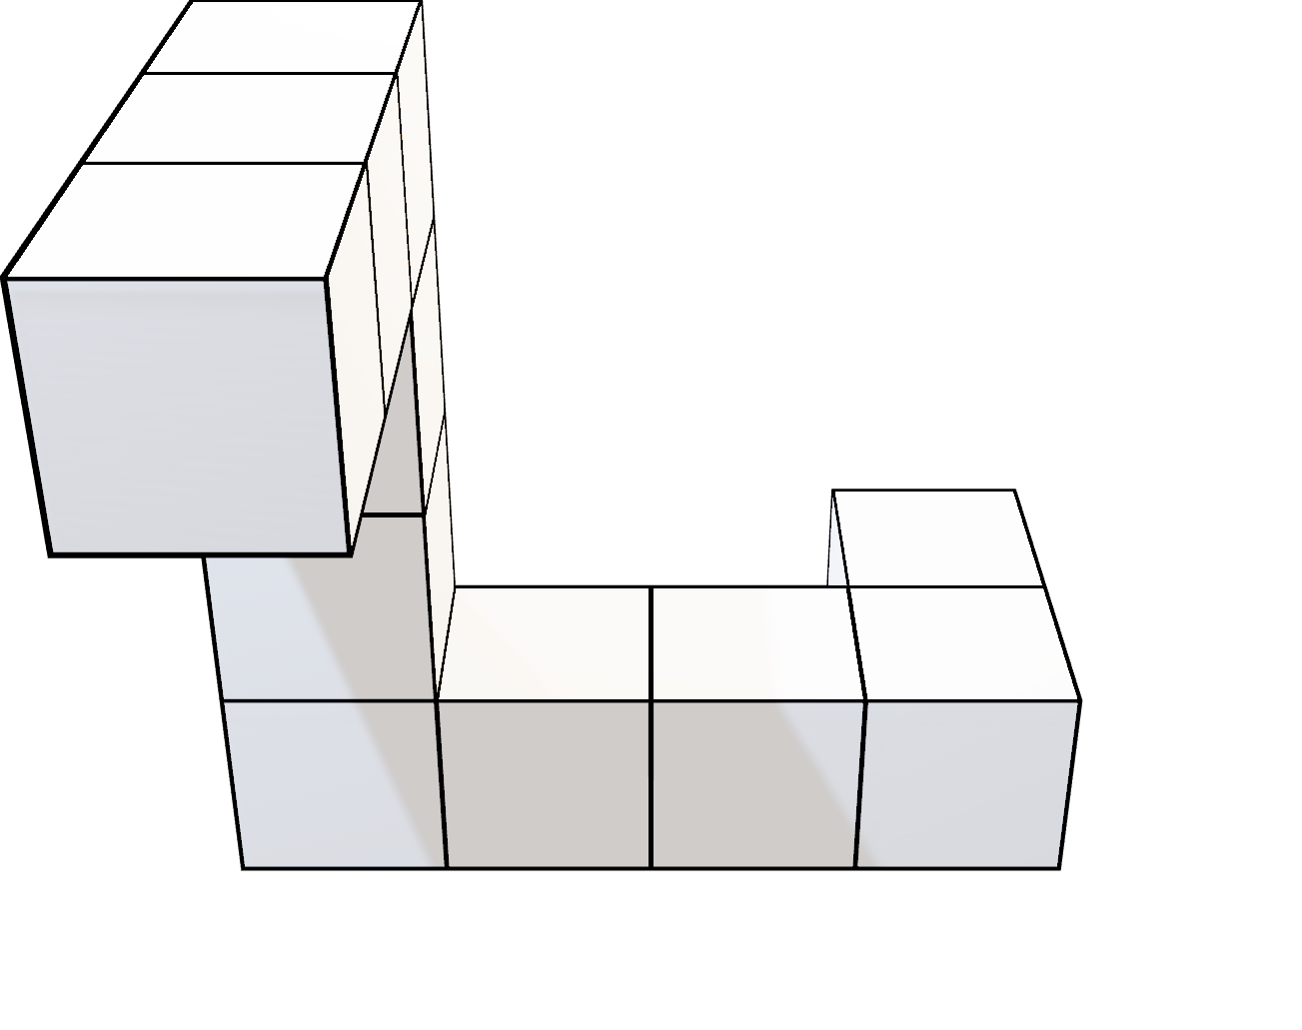
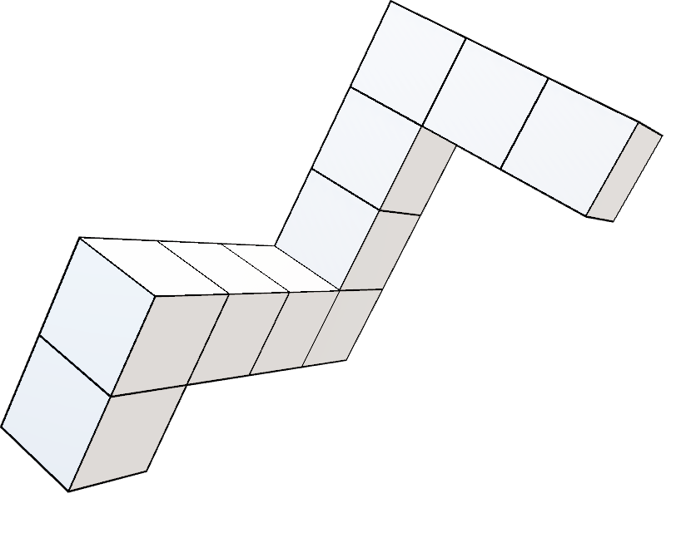
4-1
4-3

Slide 14
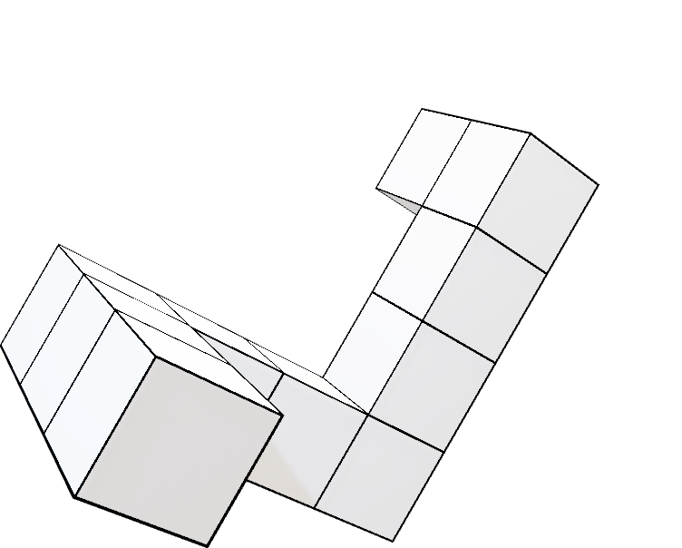
4-1
4-1

Slide 15
90°

Slide 16
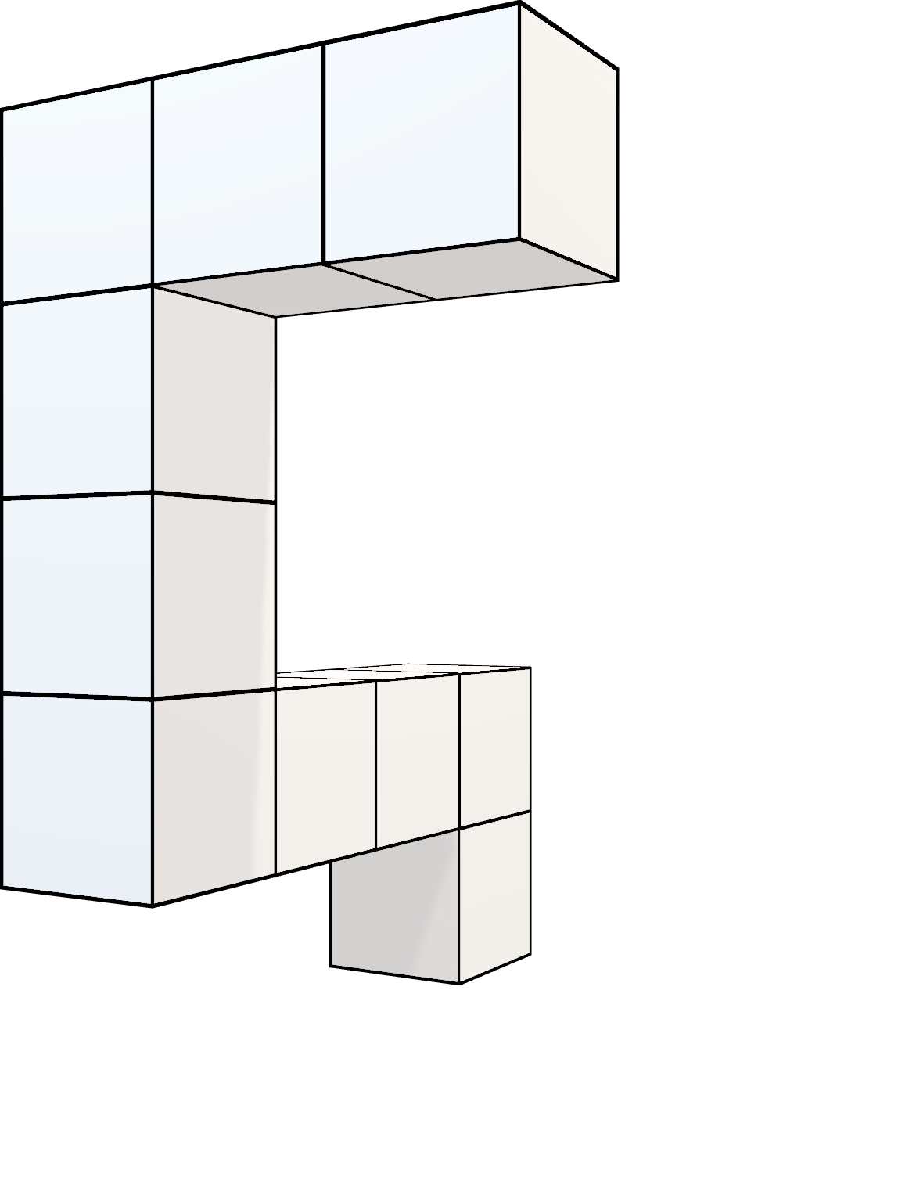
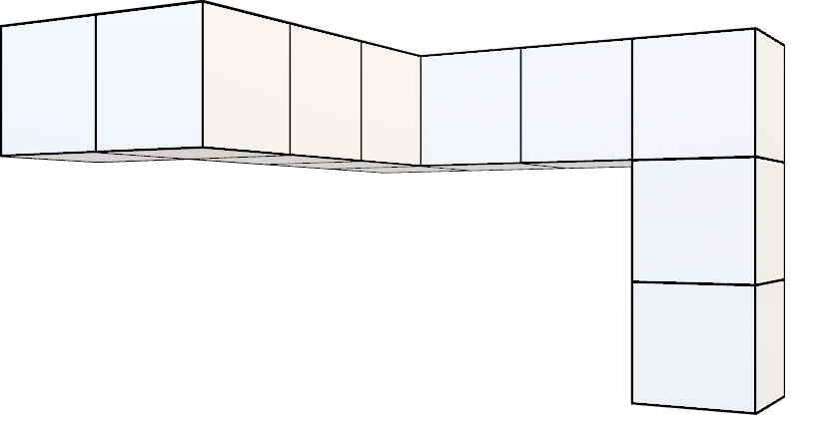
5-1
5-2

Slide 17
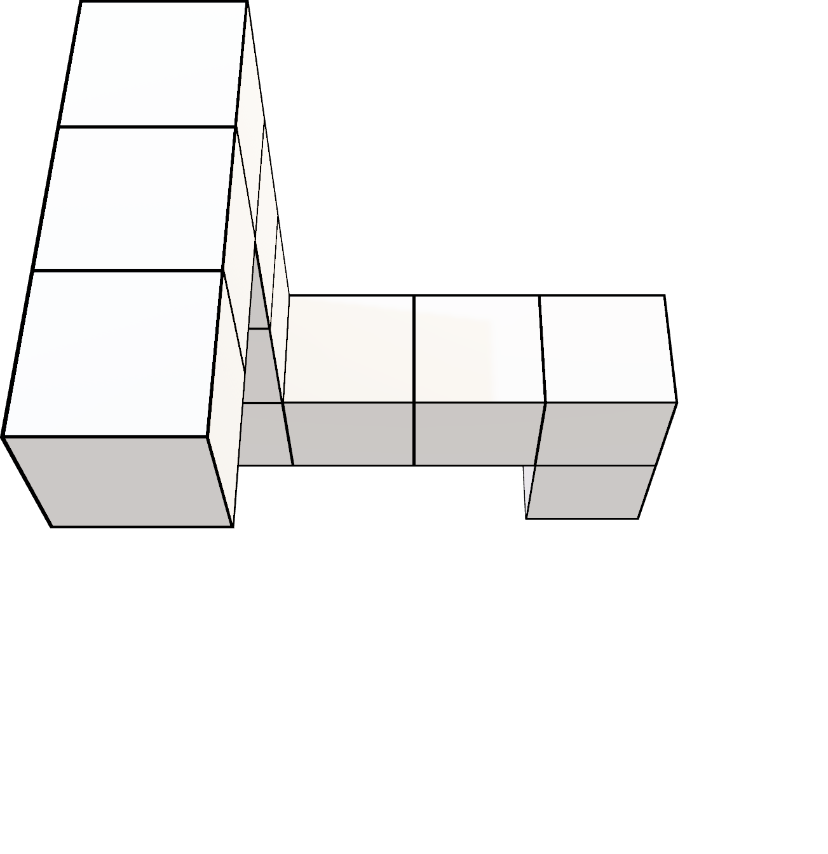
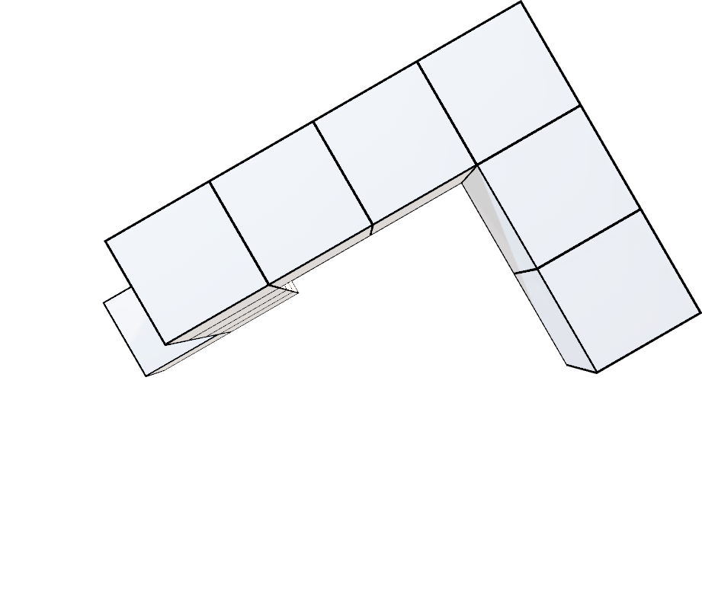
5-1
5-1

Slide 18

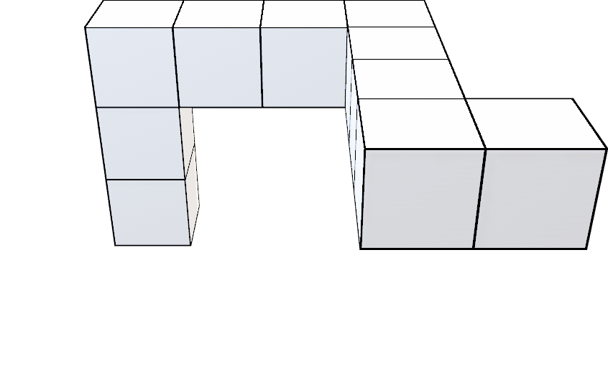
6-1
6-2

Slide 19
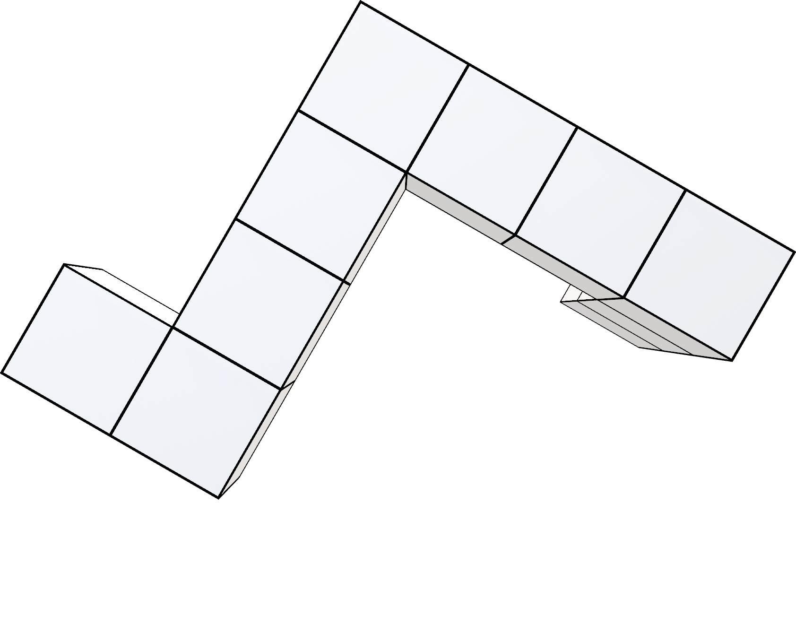
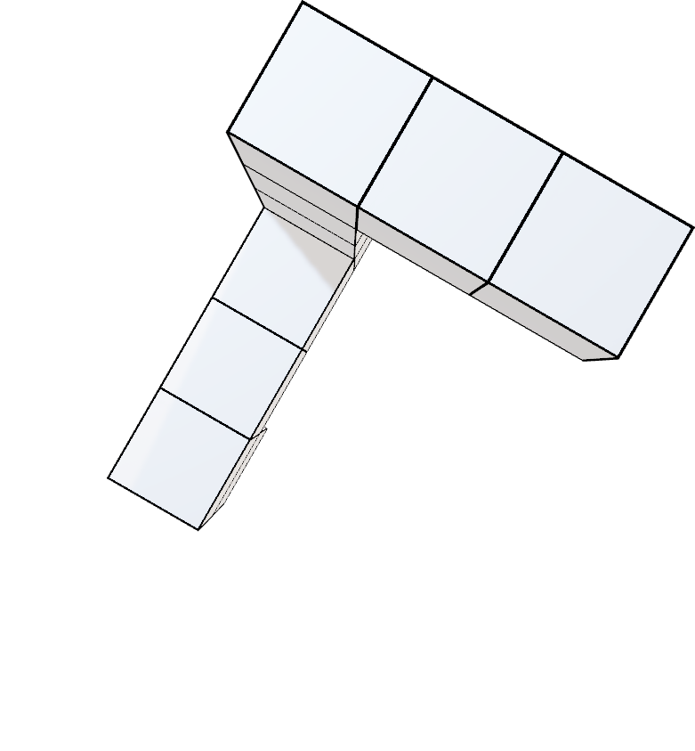
6-1
6-1

Slide 20
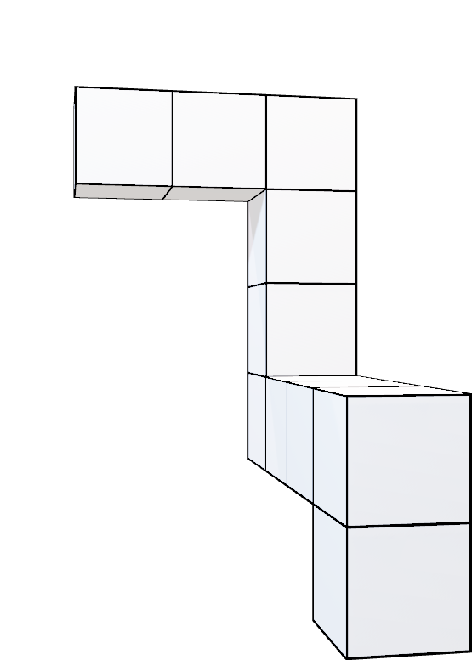
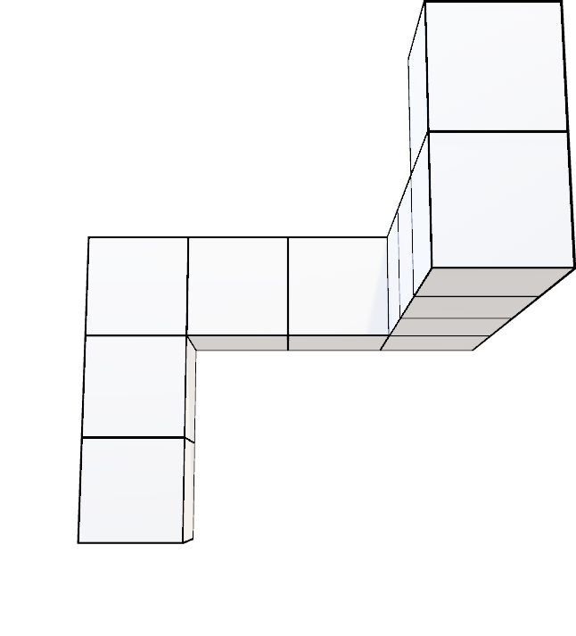
7-1
7-2

Slide 21
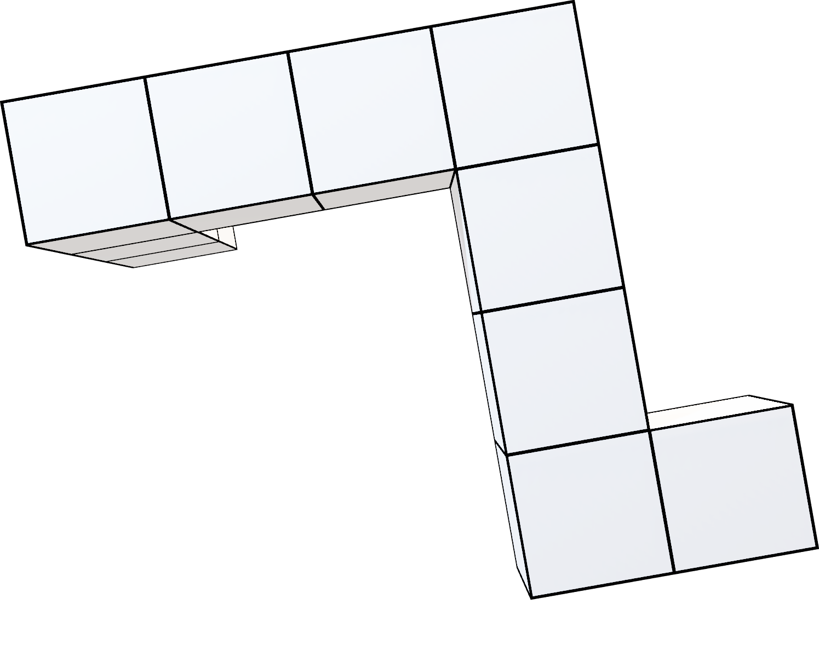
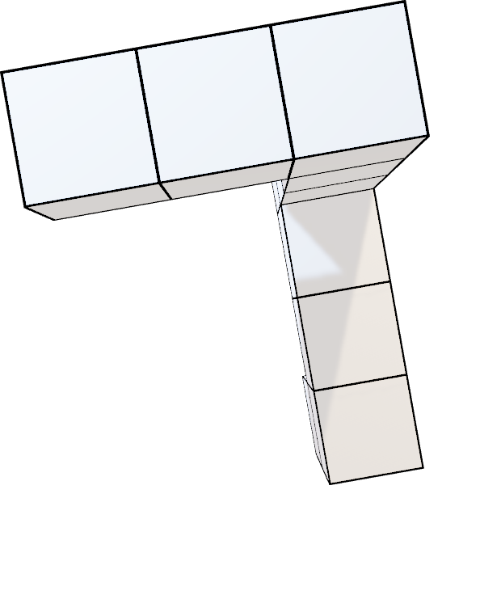
7-1
7-1

Slide 22
120°

Slide 23
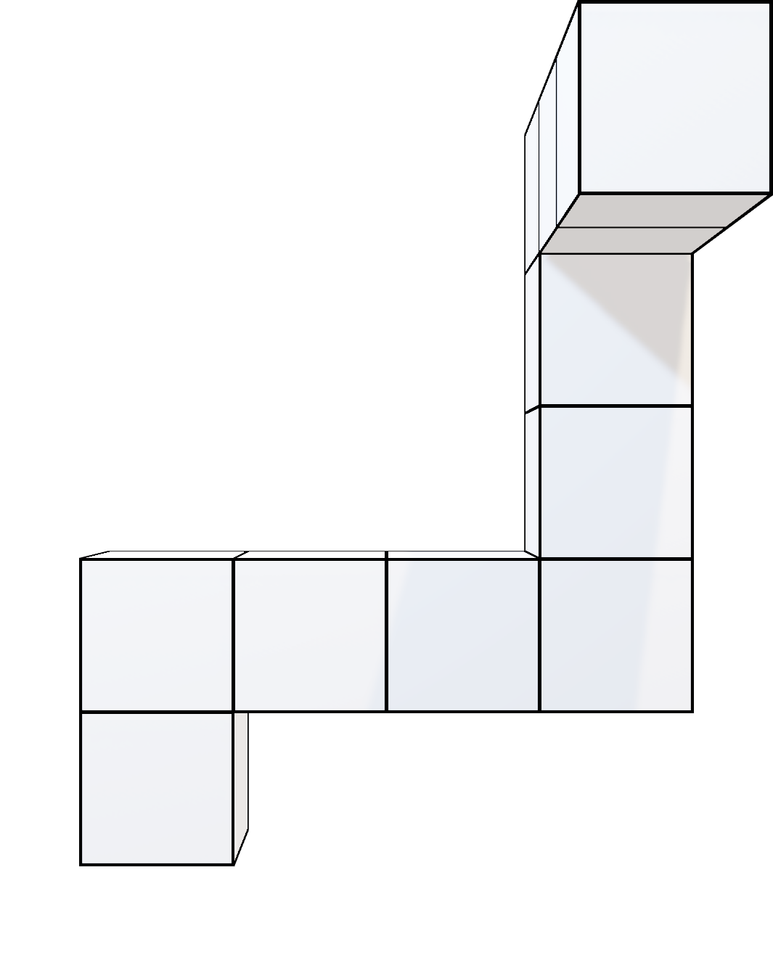
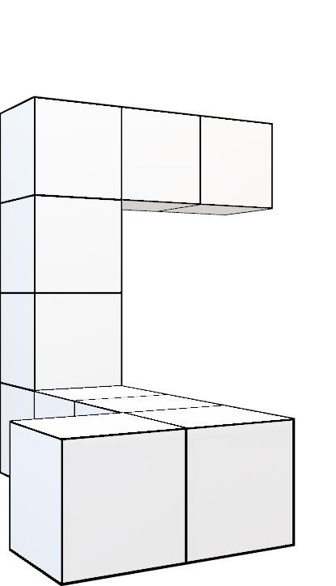
8-1
8-2

Slide 24
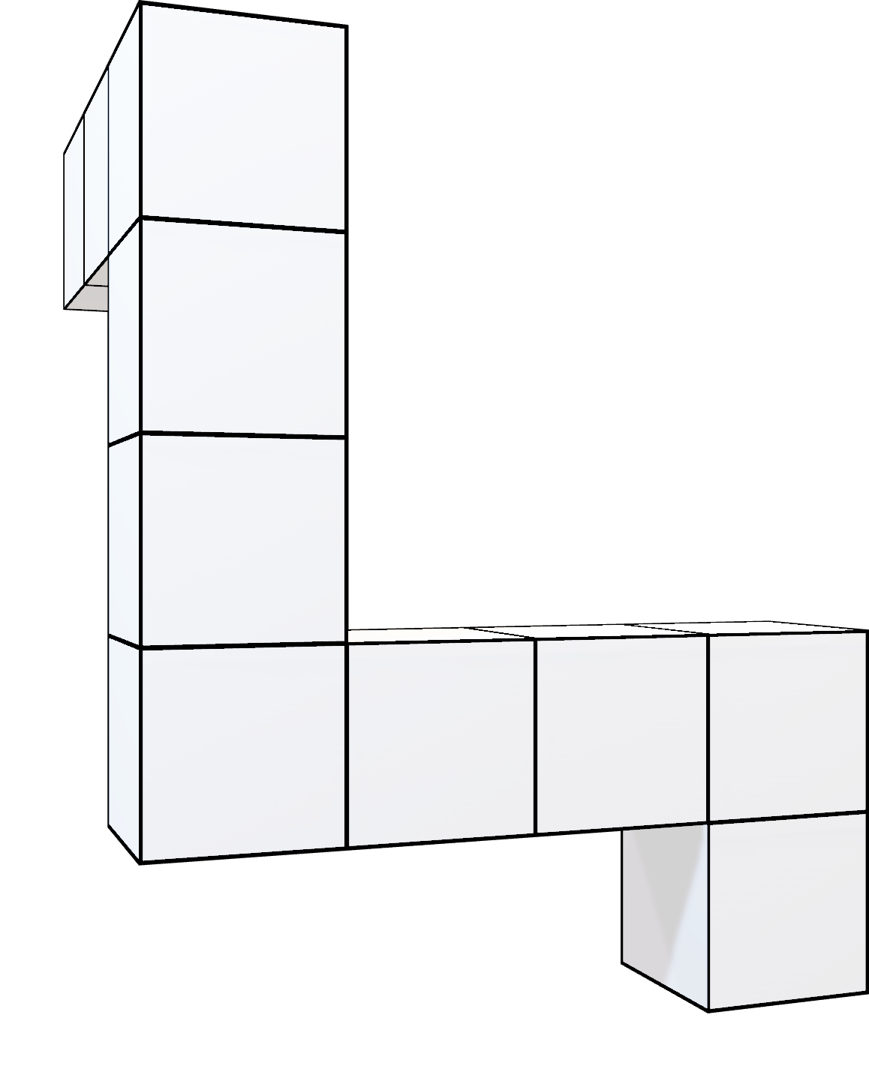
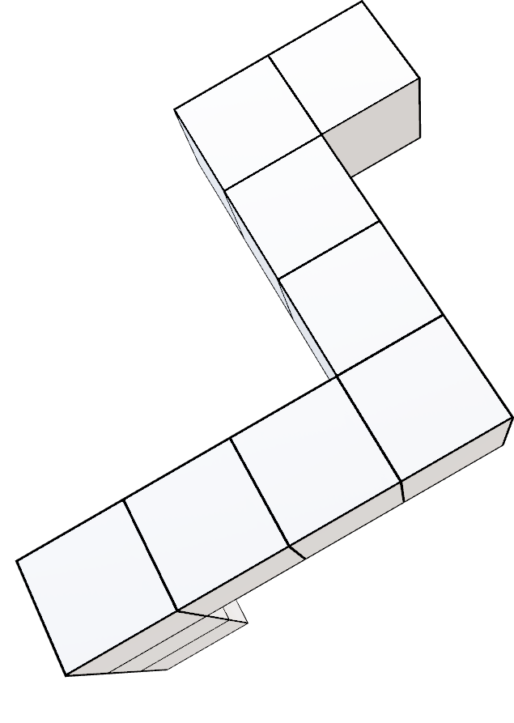
8-1
8-1

Slide 25
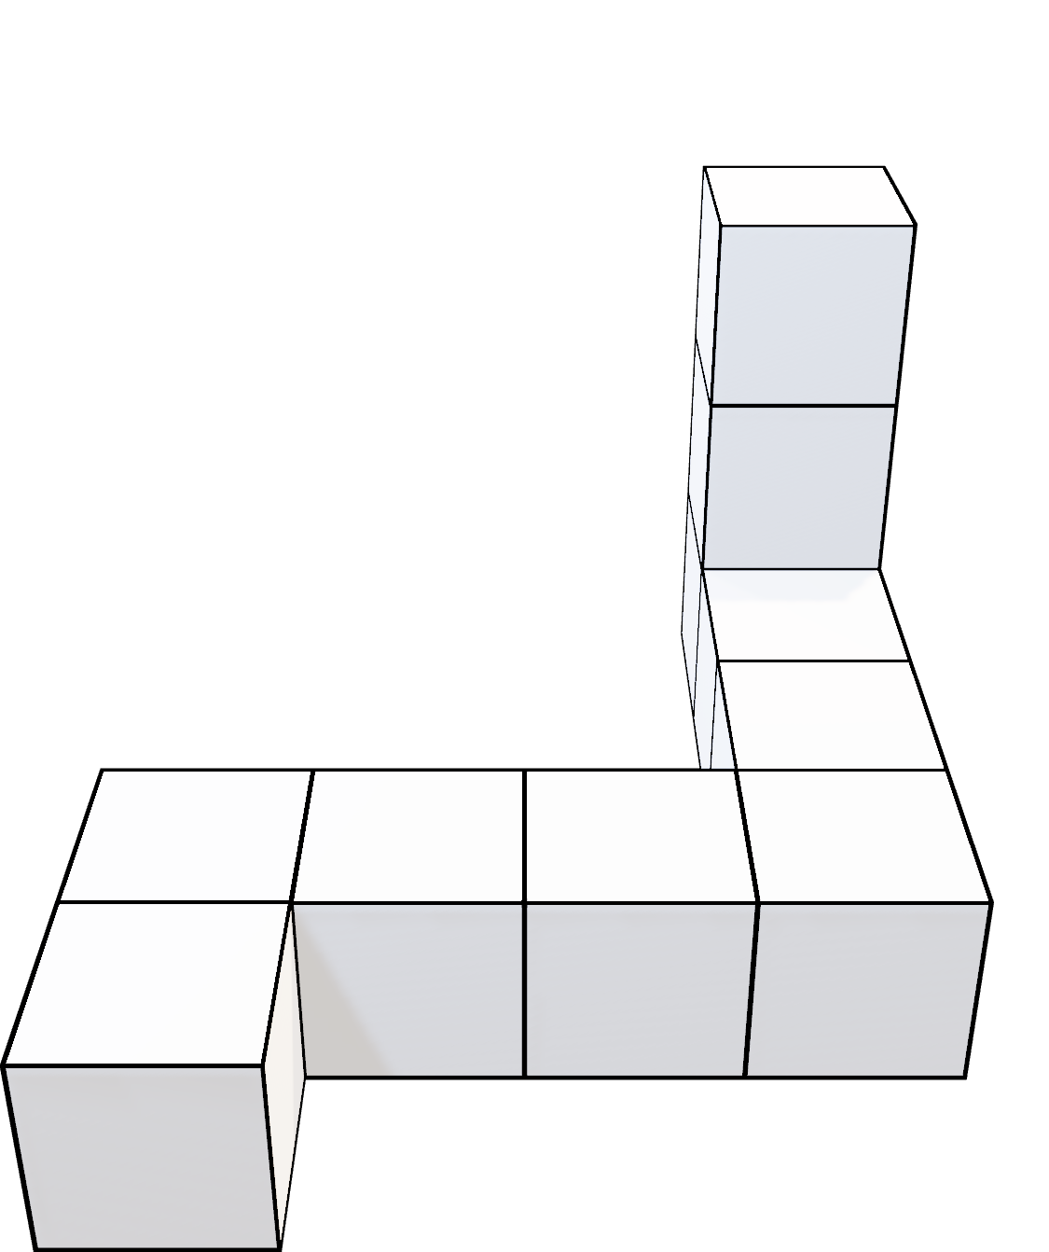
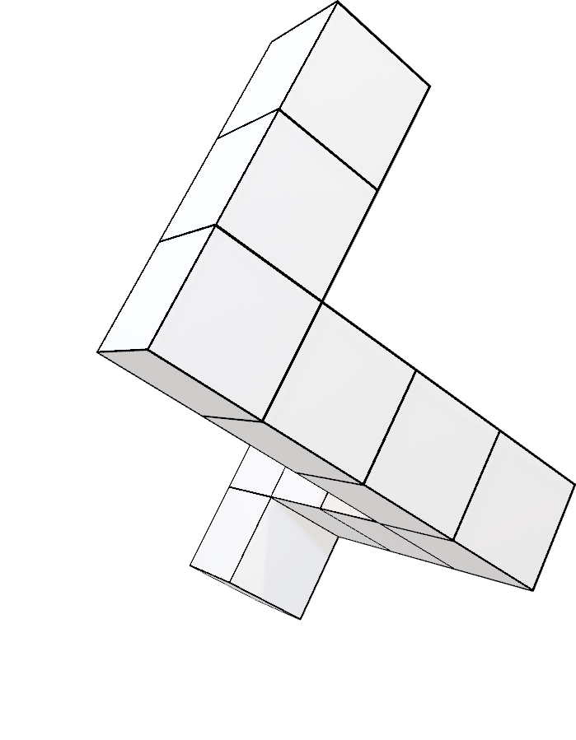
8-1
8-3

Slide 26
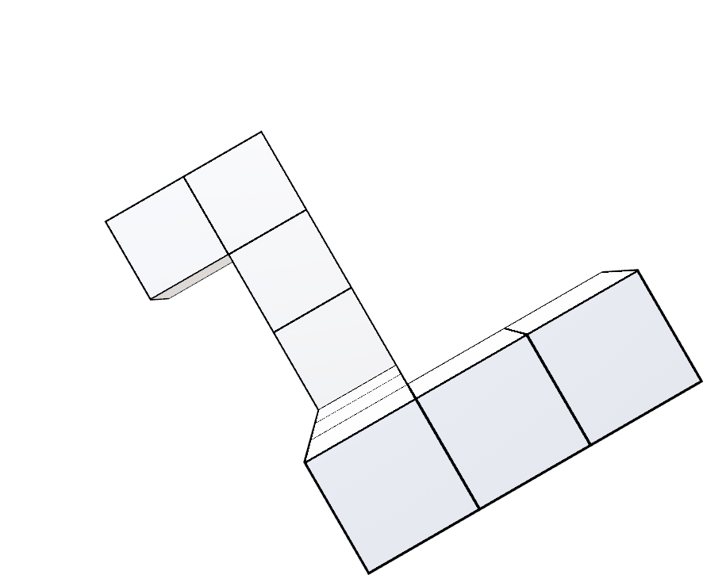
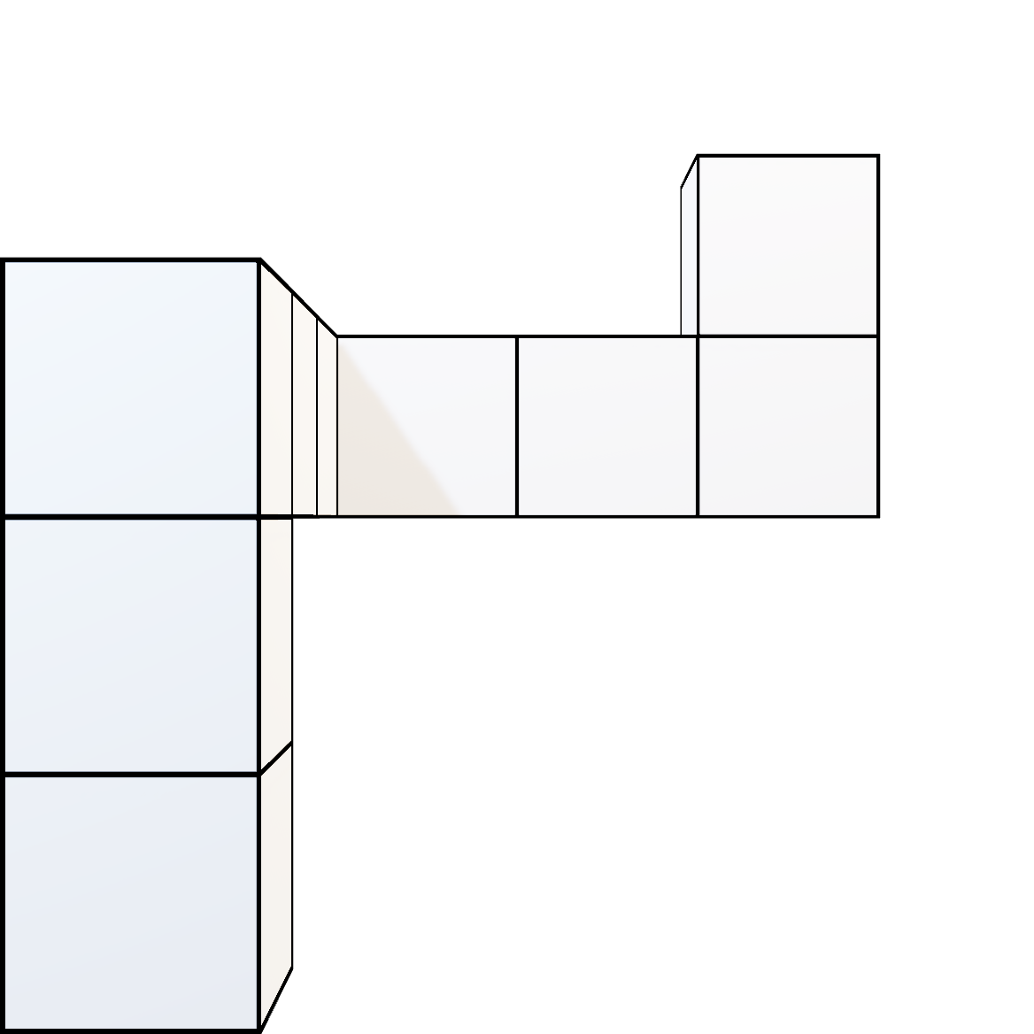
8-3
8-3

Slide 27
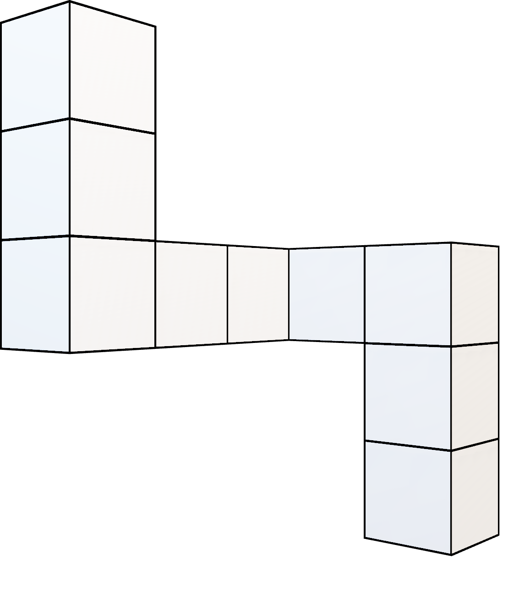
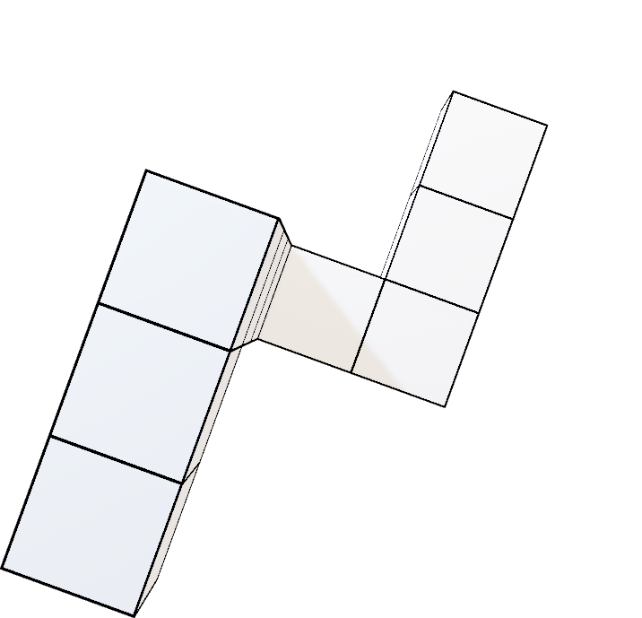
9-1
9-2

Slide 28
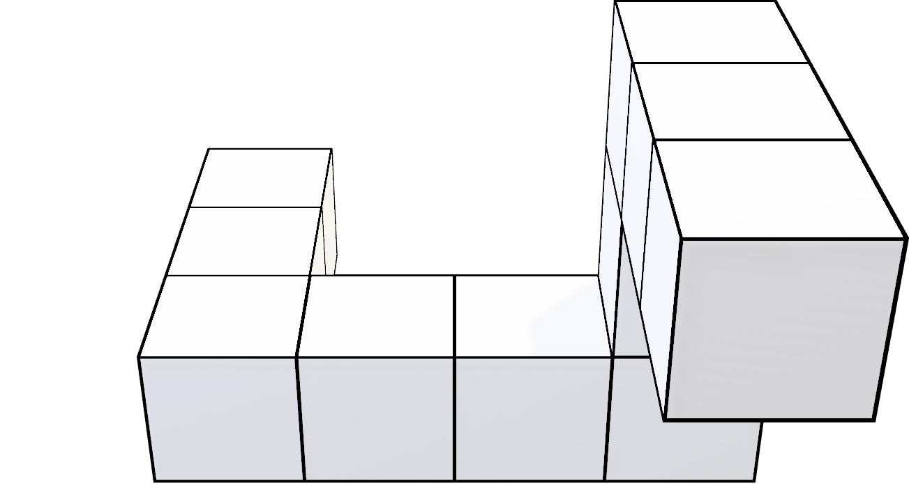
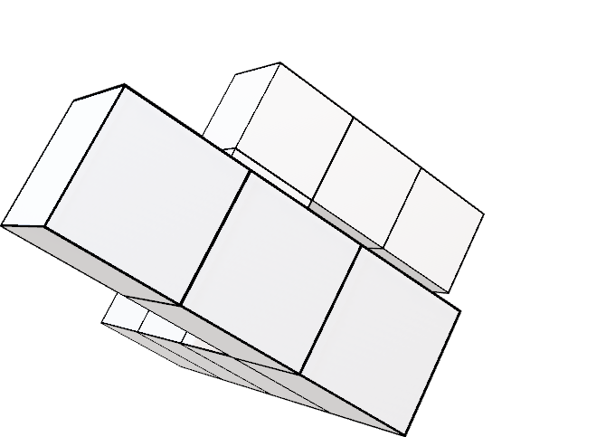
9-1
9-1

Slide 29
150°

Slide 30
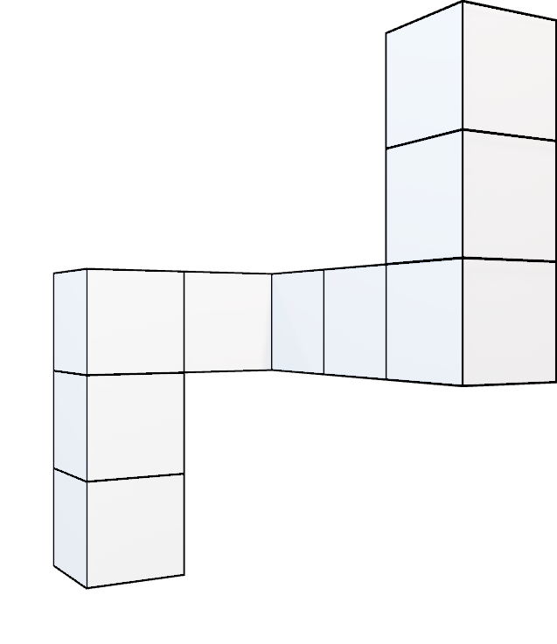
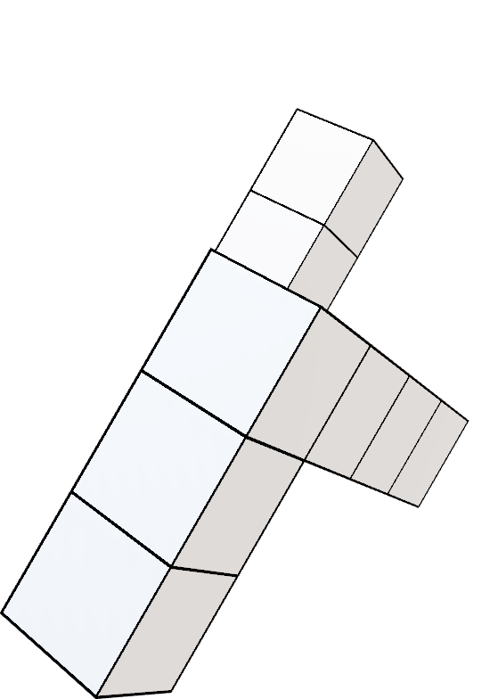
10-1
10-2

Slide 31
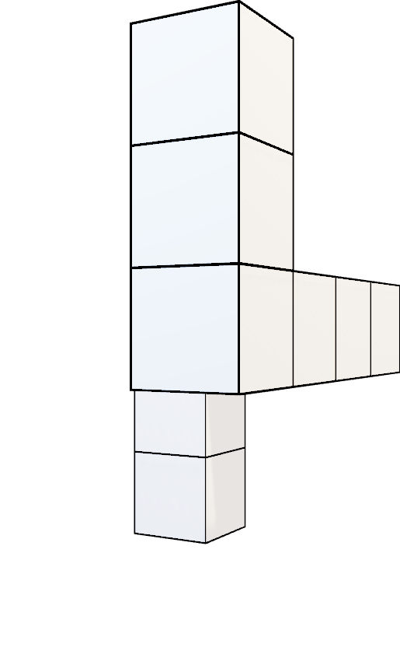
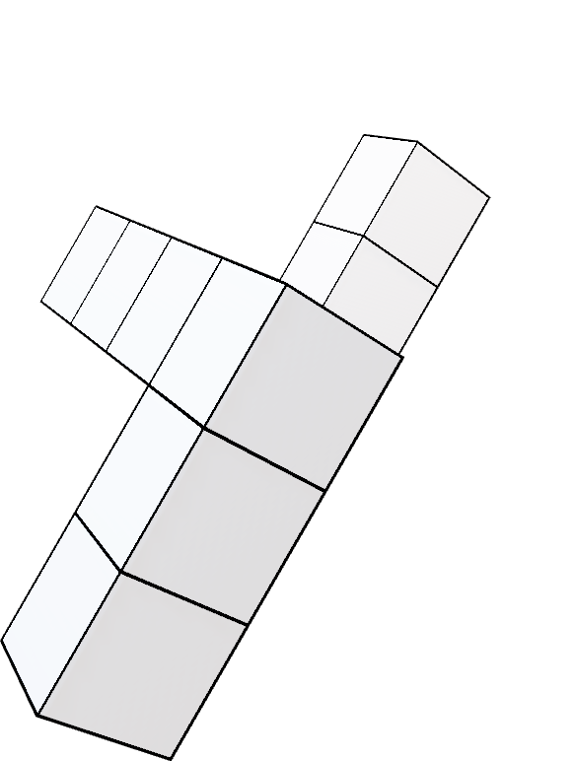
10-1
10-1

Slide 32


11-1
11-2

Slide 33


11-1
11-1

Slide 34


11-1
11-3

Slide 35


11-3
11-3

Slide 36
180°

Slide 37


12-1
12-2

Slide 38


12-1
12-1

Slide 39


12-1
12-3

Slide 40


12-3
12-3

Slide 41


13-1
13-2

Slide 42


13-1
13-1

Slide 43
210°

Slide 44


13-1
13-3

Slide 45


13-3
13-3

Slide 46


14-1
14-2

Slide 47


14-1
14-1

Slide 48


15-1
15-2

Slide 49


15-1
15-1

Slide 50
240°

Slide 51


16-1
16-2

Slide 52


16-1
16-1

Slide 53


16-1
16-3

Slide 54


16-3
16-3

Slide 55


17-1
17-2

Slide 56


17-1
17-1

Slide 57
270°

Slide 58


18-1
18-2

Slide 59


18-1
18-1

Slide 60


19-1
19-2

Slide 61


19-1
19-1

Slide 62


20-1
20-2

Slide 63


20-2
20-2

